Slide 1


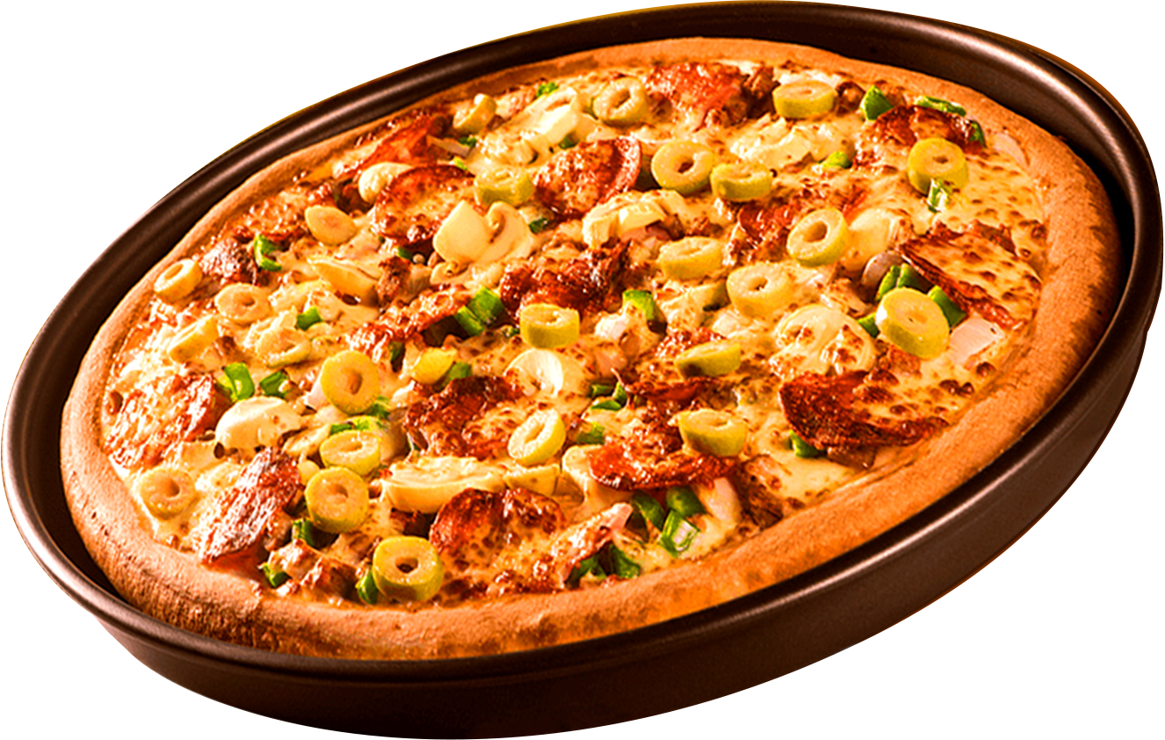
Where Every Slice is a Taste of Perfection
WELCOME TO
PIZZA RESTO
ORDER
NOW
Start your slice

Slide 2
PROJECT OVERVIEW
Project Title:
Pizza Resto sales and Operations Analysis
"To analyze sales and operational data to generate actionable insights for improving customer satisfaction and revenue growth."
Objective:
Approach:
Collected, cleaned, and explored data from PizzaHut's database.
Answered key business questions using SQL queries.
Visualized insights to present findings effectively.

Slide 3
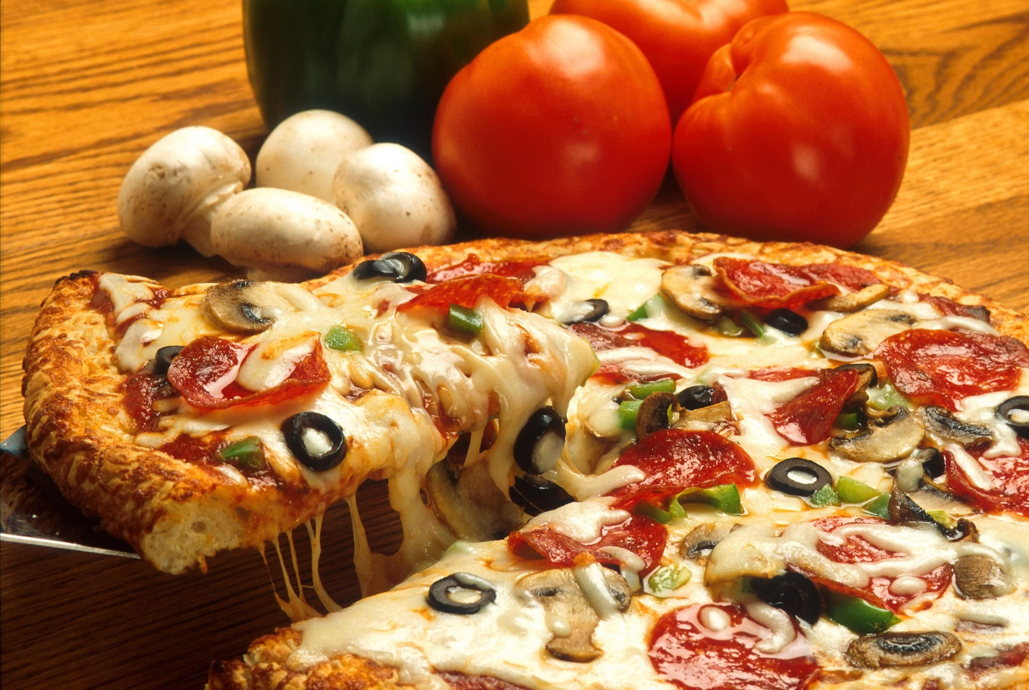
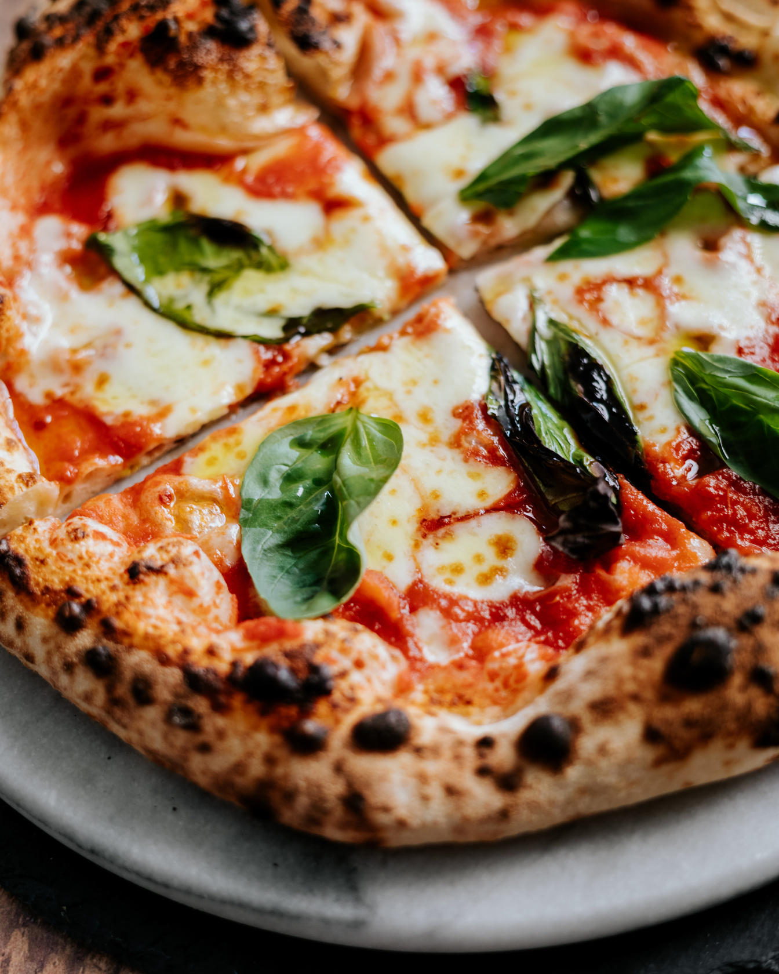
ABOUT OUR PIZZA RESTO
Our Passion for Pizza
Pizza Resto, a global leader in the pizza industry, was founded in 1978 and is renowned for its delicious pizzas, innovative menu, and exceptional dining experience. With a presence in over 100 countries, it serves millions of customers daily through dine-in, takeaway, and delivery services. Known for its iconic pan pizza and diverse offerings, PizzaHut combines quality, variety, and convenience to cater to pizza lovers worldwide.

Slide 4
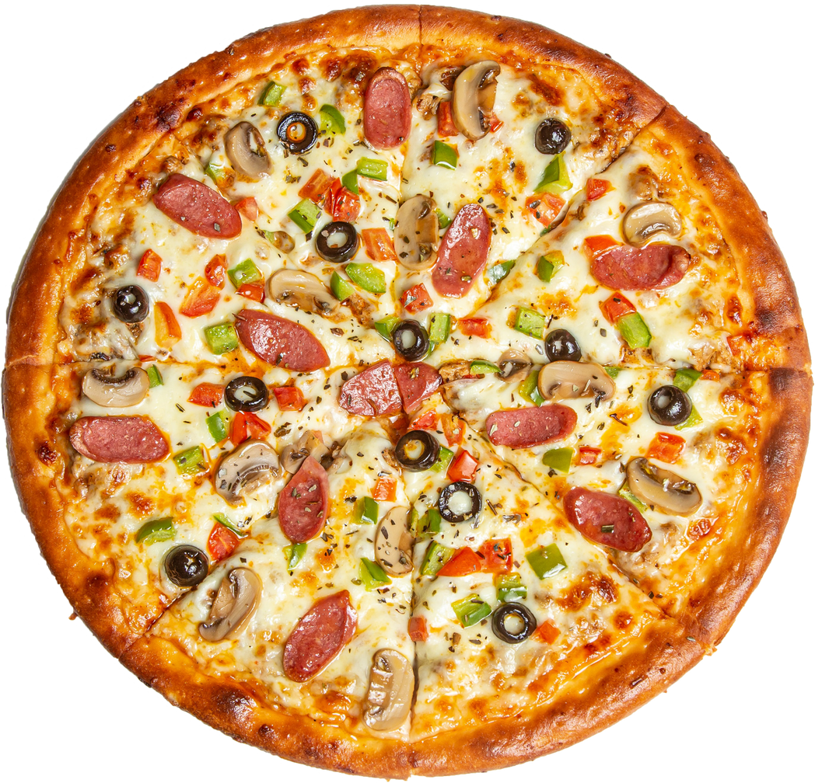
BUSINESS PROBLEM
OPTIMIZING PIZZA SALES AND OPERATIONAL EFFICIENCY FOR PIZZAHUT"
PizzaHut aims to improve its overall sales performance, profitability, and customer satisfaction by analyzing key aspects of its operations. These include understanding customer preferences, identifying top revenue-generating products, optimizing the menu, and analyzing purchasing patterns over time. The ultimate goal is to generate actionable insights for strategic decision-making and operational efficiency.
ORDER
NOW

Slide 5
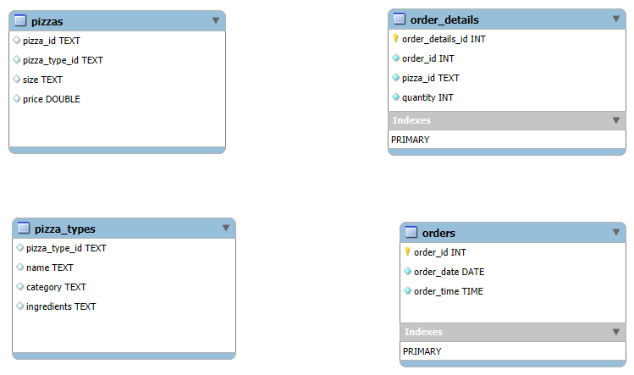
DATABASE SCHEMA

Slide 6

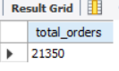
Q1. RETRIEVE THE TOTAL NUMBER OF ORDERS PLACED.

Slide 7
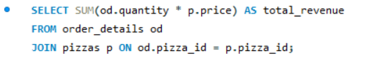
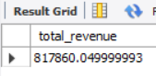
Q2. CALCULATE THE TOTAL REVENUE GENERATED FROM PIZZA SALES.

Slide 8
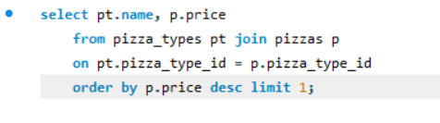
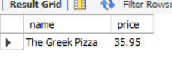
Q3. IDENTIFY THE HIGHEST-PRICED PIZZA.

Slide 9
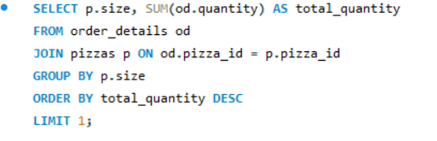
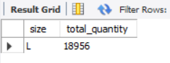
Q4. IDENTIFY THE MOST COMMON
PIZZA SIZE ORDERED.

Slide 10
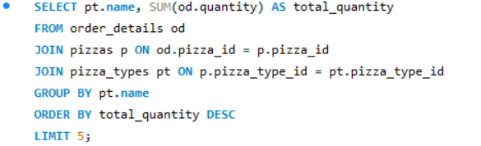
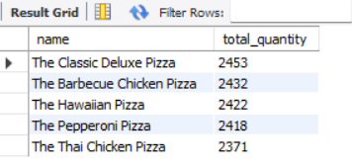
Q5. LIST THE TOP 5 MOST ORDERED PIZZA TYPES ALONG WITH THEIR QUANTITIES.

Slide 11
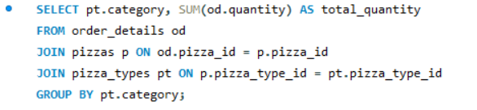
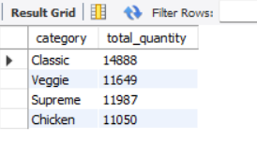
Q6. JOIN THE NECESSARY TABLES TO FIND THE TOTAL QUANTITY OF EACH PIZZA CATEGORY ORDERED.

Slide 12
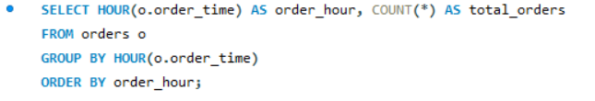
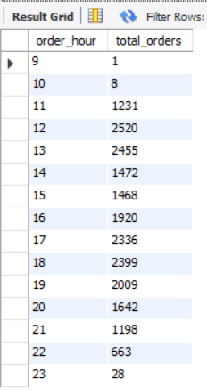
Q7. DETERMINE THE DISTRIBUTION OF ORDERS BY HOUR OF THE DAY.

Slide 13
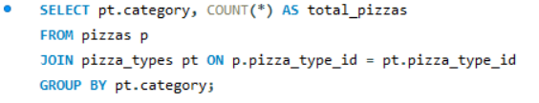
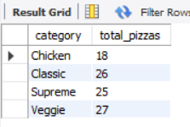
Q8. JOIN RELEVANT TABLES TO FIND THE CATEGORY-WISE DISTRIBUTION OF PIZZAS.

Slide 14
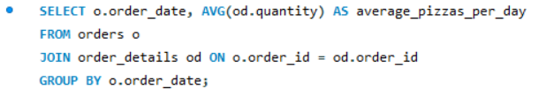
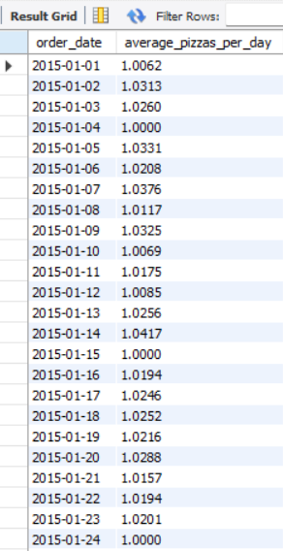
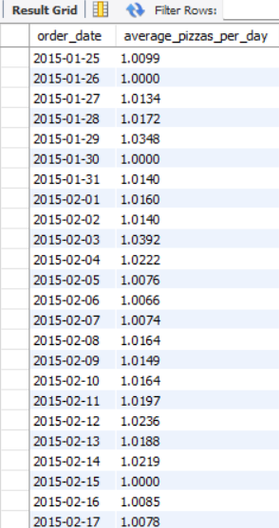
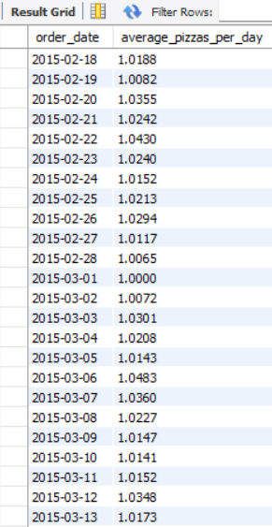
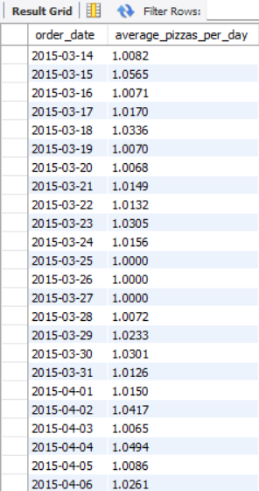
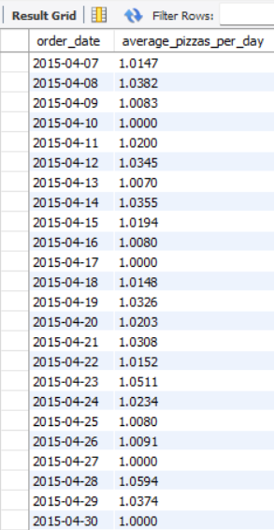
Q9. GROUP THE ORDERS BY DATE AND CALCULATE THE AVERAGE NUMBER OF PIZZAS ORDERED PER DAY.

Slide 15
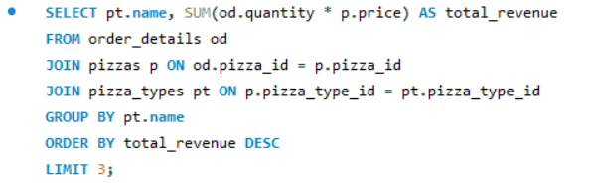
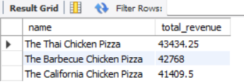
Q10. DETERMINE THE TOP 3 MOST ORDERED PIZZA TYPES BASED ON REVENUE.

Slide 16
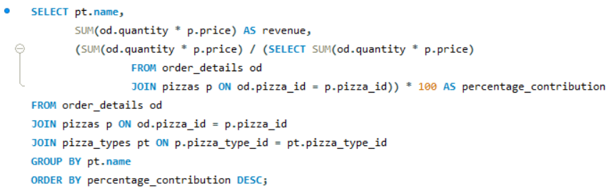
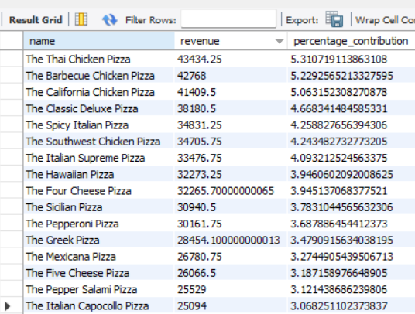
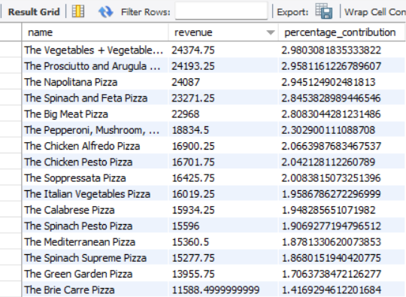
Q11. CALCULATE THE PERCENTAGE CONTRIBUTION OF EACH PIZZA TYPE TO TOTAL REVENUE.

Slide 17
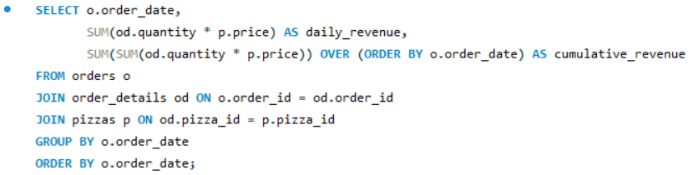
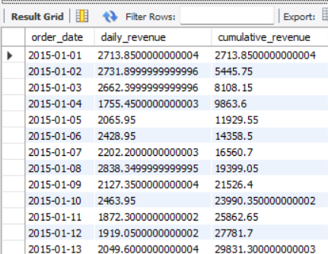
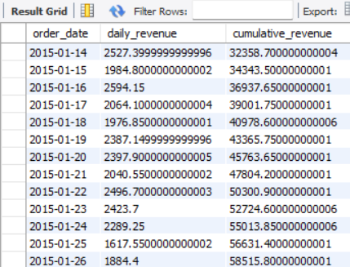
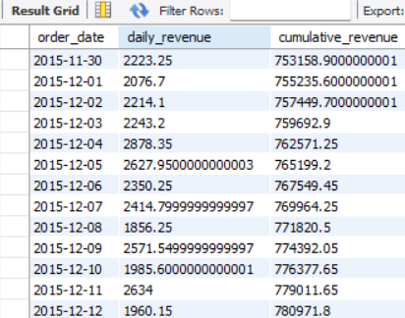
Q12. ANALYZE THE CUMULATIVE REVENUE GENERATED OVER TIME.

Slide 18
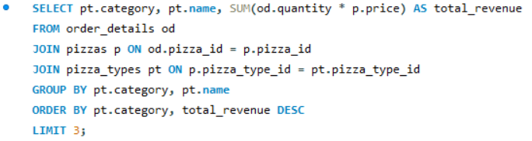
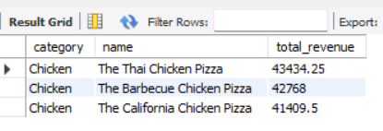
Q13. DETERMINE THE TOP 3 MOST ORDERED PIZZA TYPES BASED ON REVENUE FOR EACH PIZZA CATEGORY.

Slide 19
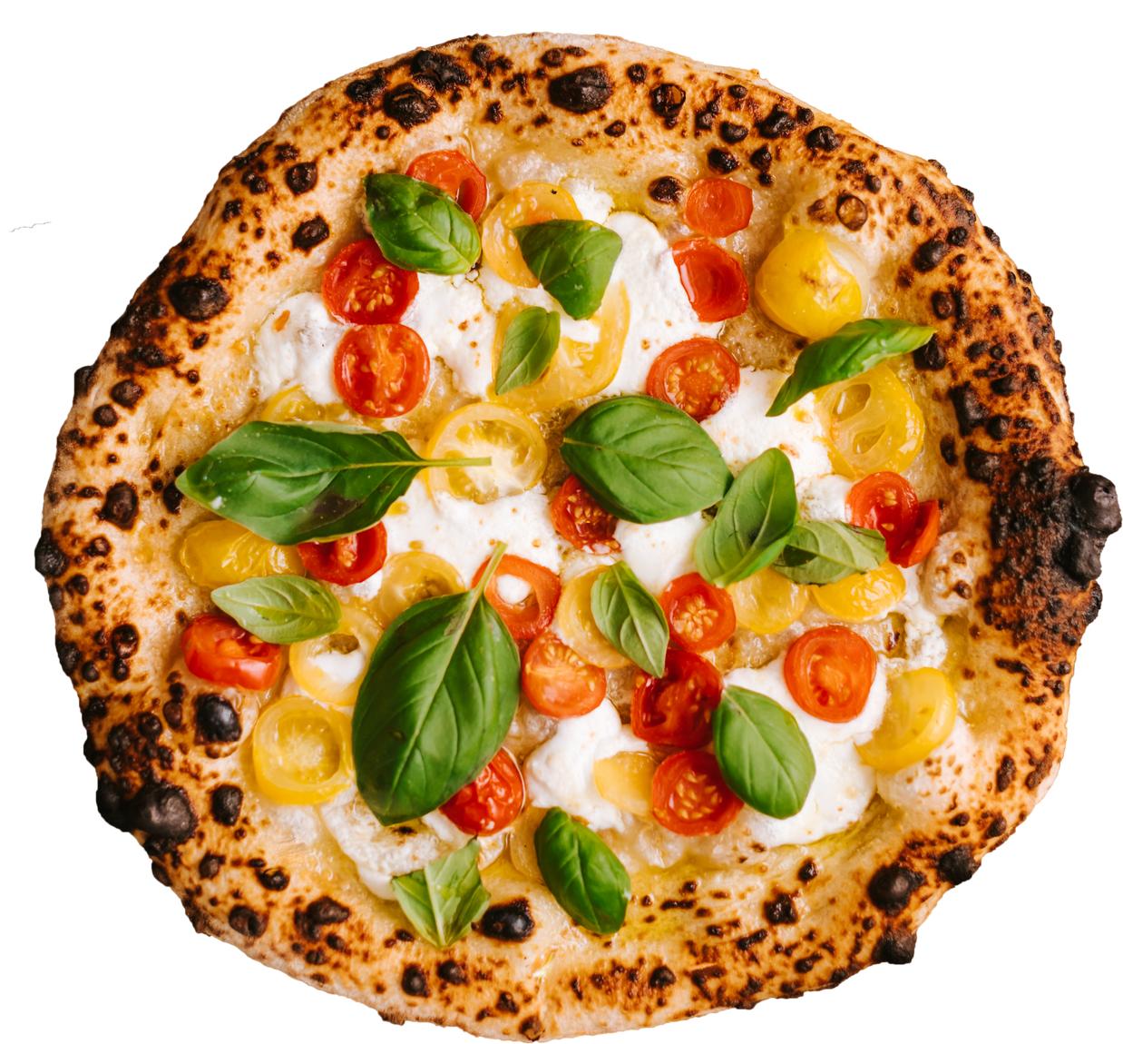
FINAL CONCLUSION
Key Findings:
The most common pizza size is Large, showing customer preference for value and sharing-sized pizzas.
The highest-priced pizza is Truffle Deluxe ($35), positioned as a premium product.
• Top 5 most ordered pizzas (e.g., Margherita, BBQ Chicken) dominate sales and customer preferences.
Peak demand hours occur 7:00 PM - 9:00 PM, with weekend and holiday sales showing significant spikes.
•Non-vegetarian pizzas contribute 60% of total orders, but vegetarian options also have a consistent demand.
The Pareto Principle is evident: a few pizza types contribute the majority of revenue.

Slide 20
RECOMMENDATINS:
1. Promotions: Focus campaigns around large pizzas and top-performing pizza types. Offer discounts during low-demand hours to boost sales.
2. Menu Engineering: Highlight high-demand and high-revenue pizzas while reviewing underperforming options for improvement or replacement.
3. Operational Efficiency: Align staffing and inventory with peak hours and days. Use data insights to avoid overstocking during low-demand times.
4. Seasonal Planning: Capitalize on weekend and holiday trends with targeted promotions and sufficient inventory.
By leveraging these insights, PizzaHut can refine its strategies to enhance customer satisfaction, maximize profitability, and ensure sustainable growth.

Slide 21
Pizza Resto Presentation
THANK YOU
FOR ATTENTION

